Slide 1


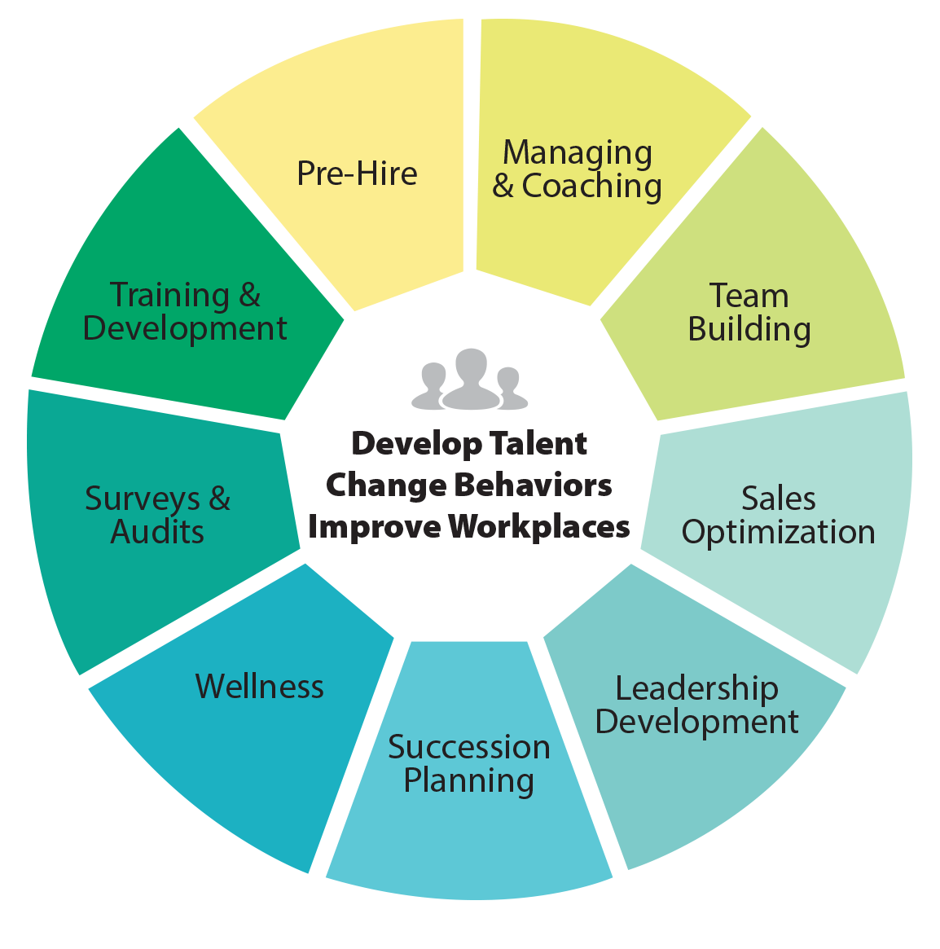
Creating an Great Workforce in today’s talent marketplace - Workshop
Cathy Light, CEO
Assessment Leaders, LLC.
Vistage Presentation 2017
VISTAGE SPEAKER AND RESOURCE PARTNER

Slide 2
DISCUSSION POINTS:
Why and How to Utilize Assessment Tools
Hiring Right in Today’s Competitive Labor Market
Why Your Culture Plays a Huge Role in Growing Your Business
Create a Learning Organization to Retain Your Workforce
Pulling it All Together

Slide 3
Three opportunities for your company to impact the performance and retention of your people
1
2
3
Selection
Process
After They
Are Hired
Back
Door

Slide 4

Door 1
Selection Process
1
Benchmark to recruit
(our Profile XT for Job Match is essential—use your
top performers to benchmark)
Develop a “most wanted” list
Hire Top Performers!

Slide 5

Door 2
After They Are Hired
2
Next…training and
coaching come into play
Not performing at an experienced level for
the job costs in terms of:
  Opportunities missed
  Resources invested
  The effect on others who
  must compensate during
  thetraining period
Takes time before the problems become apparent—
time is expensive

Slide 6


Door 3
Back Door
3
“It is difficult and expensive to train your way out of a bad hiring decision.”
When top performers leave, you are
dealing with another set of problems
When an employee doesn’t work out, you either redeploy
the marginal employees to another department and hope
for better results, or exit the employee from the company

Slide 7
Use All of Your Resources
Interview
14%
Reference Checking
26%
Personality Testing
38%
Abilities Testing
54%
Interests Testing
66%
Job Matching
75%
Sources: Professor Mike Smith, University of Manchester, August 1994
John E. Hunter and Ronda F. Hunter, Validity and Utility of Alternative Predictors of Job Performance,
Psychological Bulletin, Vol. 96, No.1, 1984, p. 90;
Robert P Tett, Douglas N. Jackson, and Mitchell Rothstein, Personality Measures as Predictors of Job Performance:
A Meta-Analytical Review, Personnel Psychology,Winter 1991, p.703. Michigan State University’s School of Business.

Slide 8
Don’t Let Your Company Become a Statistic
Corporate America loses $11 billion a year to employee turnover…
Avoid Hiring Mistakes
“
Chances are good that up to 66% of your company’s hiring
decisions will prove to be mistakes in the first twelve months.
—Peter Drucker
Famous Management Consultant
”
Hire Right: Well-run companies make money with
average performance employees…
Only…
if they avoid hiring too many below average-performance
employee It’s a Proven Fact That…
“
It’s not experience that counts, or college degrees, or other acceptable factors… success hinges on a fit with the job.
—Harvard Business Review
”

Slide 9
Do You Accept Marginal Performance?
The most thorough selection
process imaginable costs less than
hiring the wrong person for just a day.
63% of all hiring decisions are made
during the first 4.3 minutes of an interview.
—SHRM Study
reported in USA Today
“
”

Slide 10
Seeking The Total Person
History
Resume
Past Employment
Education
Background
Check
Interview
Gut Feeling
Appearance
Personality
Interview
PAST
PRESENT
Testing and
Job Match
PXT
JOB FIT

Slide 11
The Total Person
90%:
10%:
Essence of
the Total Person
  Thinking Style
  Occupational
  Interests
  Behavioral Traits
  Job Fit
Good, but Limited Information
  Skills
  Experience
  Company Match

Slide 12
Performance Modeling
Establish Criteria
for Top Performer in
a Specific Role or Position
3 Top Performers take the XT plus 3 who are struggling
Plot Assessment Data and Develop Benchmark
Use Performance
Benchmark for
both Hiring and
Development

Slide 13
What The Profile Measures
Can
the person do the job?
Will
the person do the job?
How
will the person do the job?

Slide 14
CAN the Person Do the Job?
Can
Thinking Style
1 2 3 4 5 6 7 8 9 10
Learning Index
Verbal Skill
Verbal Reasoning
Numerical Ability
Numeric Reasoning

Slide 15
WILL the Person Do the Job?
WILL
Occupational Interests
1 2 3 4 5 6 7 8 9 10
Enterprising
Financial/Administrative
People Service
Technical
Mechanical
Creative

Slide 16
HOW the Person Will Do the Job?
HOW
Behavioral Traits
1 2 3 4 5 6 7 8 9 10
Energy Level
Assertiveness
Sociability
Manageability
Attitude
Decisiveness
Accommodating
Independence
Objective Judgment

Slide 17
The JobMatch™ Pattern
Shaded areas indicate
the JobMatch pattern
The JobMatch patterns show
requirements for the jobs
Use these patterns for:
  Placement
  Retention
  Training
  Promoting
  Managing
  Planning

Slide 18
The Profile
Good Job Match

Slide 19
The Profile—Poor Job Match
Poor Job Match

Slide 20
Why Use Assessments?
To understand talent landscape
1
To evaluate and deploy internal talent
as part of a career pathing process
2
To identify high potentials
3
To match new hires to the right jobs
4
To understand organizational priorities and practices
5

Slide 21
Our Web-Based Assessments
Our pre-hire assessments are validated
Meets all DOL, ADA and EEOC standards
Unsurpassed in ease-of-use, instant
report(s) feedback—no paperwork delays
The most state-of-the-art web technology
No IT required on your end
We can set-up your company’s virtual assessment center in just seconds

Slide 22

Background Checks
DiSC
Step One Survey
Work Environment Match
Profiles XT
Call Center Survey
Sales
Job Analysis Survey
Team Analysis
The Only Assessment
Company You’ll Need
Leadership 360 +
Customer Service
Skill Builders
Performance Indicator
  8 Development Sections

Slide 23
Our Web-Based Assessments Can
Help You With…
Pre-Employment Process
Promotion Decisions
Retention
Succession Planning
Simple Team Building
Team Engineering
Sales Competence/Strategies
Performance Problems
Day-to-Day Management
Coaching/
Development/Training Strategies

Slide 24
Our Belief
“
People are happiest and most productive
when they are fully engaged and winning
—United States Bureau of Labor Statistics
”
43%
Not formally
educated or trained
67%
Unhappy and/or dissatisfied with current position

Slide 25

Leadership Business Priorities
Create
Winning
Teams
Develop
self and
others
Collaborate
effectively
Communicate
openly
and clearly

Slide 26

Workforce Challenges
Baby Boomers Fast
Approaching Retirement
Institutional Knowledge Management not fully being addressed
Efforts around
Succession Planning
Aggressive Business Growth

Slide 27
Your Best Talent
2
  Creates
  Shareholder
  Value
1
3
  Reflects
  and Embodies
  the Culture
  Defines
  the Future

Slide 28
Why Use Assessments?
Understand talent landscape
Evaluate and deploy internal talent
as part of a career pathing process
TO:
Identify high potentials
Match new hires to the right jobs
Understand organizational priorities and practices

Slide 29
Assessment Applications
Selection
place new hire
where he/she will be
most successful
Performance
Management
gauge performance
and provide
feedback
Development assess training needs and target learning
Job Movement
(determine readiness for
promotion, appropriate
career pathing
and/or identify
high potentials for
succession purposes)

Slide 30
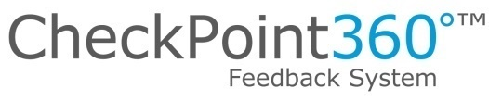


Recommended OD Tools

Slide 31


Checkpoint 360
8 Universal Leadership Competencies
  Communication
  Leadership
  Adaptability
  Relationships
1
2
3
4
  Task Management
  Production
  Development
  of Others
  Personal Development
5
6
7
8

Slide 32
Checkpoint 360
Leadership
  Instills Trust
    Keeps promises
    Can be trusted with confidential information
    Demonstrates high ethical standards
  Provides Direction
    Makes expectations clear
    Establishes a manageable workload
    Accomplishes long-term objectives by planning incremental steps
    Keeps focus on big picture while implementing details
  Delegates Responsibility

Slide 33
Use the Checkpoint to Assess Performance
Is the manager achieving business results and demonstrating leadership skills?
Is this someone to watch?
To invest in?
Why is this individual struggling? Where would he/she be better suited?

Slide 34
Checkpoint 360
Identifies areas of perceptual misalignment
Development Guidance provided
Organizational Management Analysis
  Consolidates assessment data from a entire management team to create an executive overview of management capability
    Pinpoints collective strengths and weaknesses
    Provides clarity around training needs

Slide 35
ProfileXT
Provides the deepest insight into the individual
Evaluates the Total Person
  Thinking Style
  Inherent Behavioral Traits
  Motivational/Occupational Interests
The secret ingredient: performance modeling

Slide 36
Section One: Thinking Style
Measures
  Verbal Skill
  (measures verbal skill through vocabulary)
  Verbal Reasoning
  (using words as a basis in reasoning and problem solving)
  Numerical Skill
  (measures numeric calculation ability)
  Numerical Reasoning
  (Using numbers as a basis in reasoning and problem solving )
  Learning Index
  (Derived from all of the above: an index of expected learning, reasoning and problem solving potential.)

Slide 37
Section One: Thinking Style
How someone learns will impact how quickly
they become proficient on the job
How someone processes information is relevant to
on-boarding, training and even coaching
What you look for is the person whose Thinking
Style matches those most successful in the role.

Slide 38
Section Two: Inherent Behavioral Traits
  Nine Personality Traits Assessed
  Who we are always emerges
  (especially under stress)
  The more we get to be who we are at
  work, the more successful we will be
  The more our personality is aligned with
  the job, the culture, the pace and the
  environment, the more we feel in sync
  Generally, the happier we are at work, the
  better our performance and productivity

Slide 39
Inherent Behavioral Traits
  Tendency to display endurance and capacity for a fast pace
Energy Level
  Tendency to take charge of people and situations
Assertiveness
  Tendency to be outgoing and people-oriented
Sociability
  Tendency to follow policies, accept external controls and supervision and work within
  the rules
Manageability
  Tendency to have a positive attitude regarding people and outcomes
Attitude
  Uses available info to make decisions quickly
Decisiveness
  Tendency to
  be friendly,
  co-operative, agreeable. To be a team player.
Accommodating
  Tendency to be self-reliant, self-directed, to take independent action and make own decisions
Independence
  The ability to think clearly and be objective in decision-making
Objective Judgment

Slide 40
Occupational Interests Profile
  Interested in activities associated with persuading others and presenting ideas
Enterprising
  Interested in activities such as helping people and promoting the welfare of others
People Service
  Indicates interest in activities using imagination, creativity and original ideas
Creative
  Indicates interest in activities such as organizing information or business procedures
Financial/Administrative
  Indicates interest in working with tools and equipment to produce tangible results
Mechanical
  Indicates interest in scientific activities, technical data and research
Sociability

Slide 41
The Magic Ingredient: Performance Modeling
A Performance Benchmark is developed based
upon those most successful in the role
How top performers collectively score on each factor ultimately becomes the performance model
The greater the match to the performance model, the higher the probability that an individual will be successful in that role
Important data for placement,
promotion and succession decisions

Slide 42
Performance Modeling
Establish
Criteria for Top Performer in a Specific Role or Position
3 Top
Performers
take the XT
plus 3 who are
struggling
Plot Assessment Data & Develop Benchmark
Use
Performance
Benchmark
for both Hiring
& Development

Slide 43
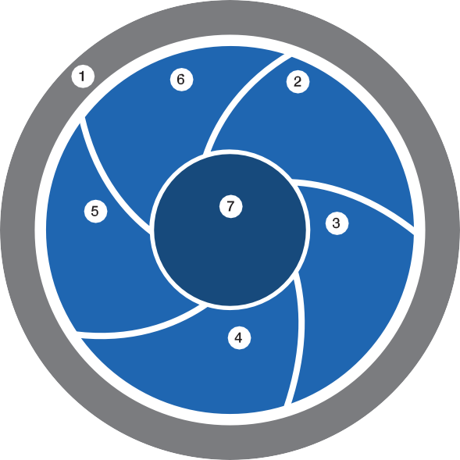
McKinsey has observed several traits of effective talent systems
Linking talent strategy to business needs
Engaging and connecting
Recruiting and
on-boarding
Training and organizational development
Creating a talent culture
Recognizing and rewarding performance
Growing leaders
SOURCE: McKinsey analysis

Slide 44
McKinsey has observed several traits of effective talent systems
  Linking talent strategy to business needs
    Changes in environment, budget, and demographics can be anticipated and addressed
  Recruiting and on-boarding
    The best processes innovate on sourcing and optimize the candidate experience
  Recognizing and rewarding performance
    Motivation is sensitive to the integrity and consistency of the link between performance, ratings, and consequences
  Growing leaders
    Leadership development can be accelerated with a cross-agency view of leader/opportunity matching and movement
  Training and organizational development
    The most effective programs are a part of a larger journey and are coupled with experiential learning components and innovations in job design
  Engaging and connecting
    Strong and cohesive social and knowledge networks can dissolve structural barriers and silos
  Creating a talent culture
    Talent cultures require foundational mind-set and behaviors among executives and staff alike
SOURCE: McKinsey analysis

Slide 45
Thank You For Your Time
Assessment Leaders puts solid information
behind every management decision!
Don’t delay… Get started today!
Cathy@AssessmentLeaders.com
www.assessmentleaders.com
1-866-864-8200

