Slide 1
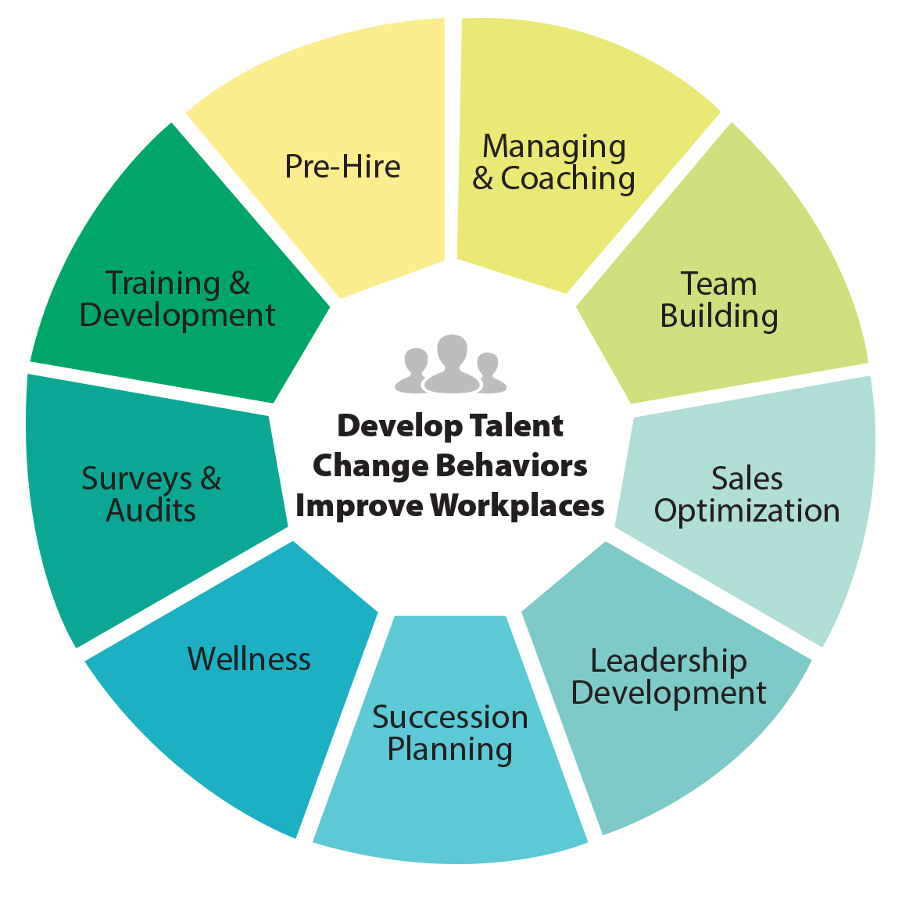
Creating an Great Workforce in today’s talent marketplace - Workshop
Cathy Light, CEO
Assessment Leaders, LLC.
Vistage Presentation 2017
VISTAGE SPEAKER AND RESOURCE PARTNER

Slide 2
DISCUSSION POINTS:
Why and How to Utilize Assessment Tools
Hiring Right in Today’s Competitive Labor Market
Why Your Culture Plays a Huge Role in Growing Your Business
Create a Learning Organization to Retain Your Workforce
Pulling it All Together

Slide 3
Three opportunities for your company to impact the performance and retention of your people
1
2
3
Selection Process
After They Are Hired
Back Door

Slide 4
Door 1 Selection Process
1
Benchmark to recruit (our Profile XT for Job Match is essential—use your top performers to benchmark)
Develop a “most wanted” list
Hire Top Performers!

Slide 5
Door 2 After They Are Hired
2
Next…training and coaching come into play
Not performing at an experienced level for the job costs in terms of:
Opportunities missed
Resources invested
The effect on others who must compensate during thetraining period
Takes time before the problems become apparent— time is expensive

Slide 6
Door 3 Back Door
3
“It is difficult and expensive to train your way out of a bad hiring decision.”
When top performers leave, you are dealing with another set of problems
When an employee doesn’t work out, you either redeploy the marginal employees to another department and hope for better results, or exit the employee from the company

Slide 7
Use All of Your Resources
Interview
14%
Reference Checking
26%
Personality Testing
38%
Abilities Testing
54%
Interests Testing
66%
Job Matching
75%
Sources: Professor Mike Smith, University of Manchester, August 1994 John E. Hunter and Ronda F. Hunter, Validity and Utility of Alternative Predictors of Job Performance, Psychological Bulletin, Vol. 96, No.1, 1984, p. 90; Robert P Tett, Douglas N. Jackson, and Mitchell Rothstein, Personality Measures as Predictors of Job Performance: A Meta-Analytical Review, Personnel Psychology,Winter 1991, p.703. Michigan State University’s School of Business.

Slide 8
Don’t Let Your Company Become a Statistic
Corporate America loses $11 billion a year to employee turnover…
Avoid Hiring Mistakes
“
Chances are good that up to 66% of your company’s hiring decisions will prove to be mistakes in the first twelve months.
—Peter Drucker Famous Management Consultant
”
Hire Right: Well-run companies make money with average performance employees…
Only…
if they avoid hiring too many below average-performance employee It’s a Proven Fact That…
“
It’s not experience that counts, or college degrees, or other acceptable factors… success hinges on a fit with the job.
—Harvard Business Review
”

Slide 9
Do You Accept Marginal Performance?
The most thorough selection process imaginable costs less than hiring the wrong person for just a day.
63% of all hiring decisions are made during the first 4.3 minutes of an interview.
—SHRM Study reported in USA Today
“
”

Slide 10
Seeking The Total Person
History Resume Past Employment Education Background Check
Interview Gut Feeling Appearance Personality Interview
PAST
PRESENT
Testing and Job Match PXT
JOB FIT

Slide 11
The Total Person
90%:
10%:
Essence of the Total Person
Thinking Style
Occupational Interests
Behavioral Traits
Job Fit
Good, but Limited Information
Skills
Experience
Company Match

Slide 12
Performance Modeling
Establish Criteria for Top Performer in a Specific Role or Position
3 Top Performers take the XT plus 3 who are struggling
Plot Assessment Data and Develop Benchmark
Use Performance Benchmark for both Hiring and Development

Slide 13
What The Profile Measures
Can the person do the job?
Will the person do the job?
How will the person do the job?

Slide 14
CAN the Person Do the Job?
Can
Thinking Style
1 2 3 4 5 6 7 8 9 10
Learning Index
Verbal Skill
Verbal Reasoning
Numerical Ability
Numeric Reasoning

Slide 15
WILL the Person Do the Job?
WILL
Occupational Interests
1 2 3 4 5 6 7 8 9 10
Enterprising
Financial/Administrative
People Service
Technical
Mechanical
Creative

Slide 16
HOW the Person Will Do the Job?
HOW
Behavioral Traits
1 2 3 4 5 6 7 8 9 10
Energy Level
Assertiveness
Sociability
Manageability
Attitude
Decisiveness
Accommodating
Independence
Objective Judgment

Slide 17
The JobMatch™ Pattern
Shaded areas indicate the JobMatch pattern
The JobMatch patterns show requirements for the jobs
Use these patterns for:
Placement
Retention
Training
Promoting
Managing
Planning

Slide 18
The Profile
Good Job Match

Slide 19
The Profile—Poor Job Match
Poor Job Match

Slide 20
Why Use Assessments?
To understand talent landscape
1
To evaluate and deploy internal talent as part of a career pathing process
2
To identify high potentials
3
To match new hires to the right jobs
4
To understand organizational priorities and practices
5

Slide 21
Our Web-Based Assessments
Our pre-hire assessments are validated
Meets all DOL, ADA and EEOC standards
Unsurpassed in ease-of-use, instant report(s) feedback—no paperwork delays
The most state-of-the-art web technology
No IT required on your end
We can set-up your company’s virtual assessment center in just seconds

Slide 22
Background Checks
DiSC
Step One Survey
Work Environment Match
Profiles XT
Call Center Survey
Sales
Job Analysis Survey
Team Analysis
The Only Assessment Company You’ll Need
Leadership 360 +
Customer Service
Skill Builders
Performance Indicator
8 Development Sections

Slide 23
Our Web-Based Assessments Can Help You With…
Pre-Employment Process
Promotion Decisions
Retention
Succession Planning
Simple Team Building
Team Engineering
Sales Competence/Strategies
Performance Problems
Day-to-Day Management
Coaching/ Development/Training Strategies

Slide 24
Our Belief
“
People are happiest and most productive when they are fully engaged and winning
—United States Bureau of Labor Statistics
”
43% Not formally educated or trained
67% Unhappy and/or dissatisfied with current position

Slide 25
Leadership Business Priorities
Create Winning Teams
Develop self and others
Collaborate effectively
Communicate openly and clearly

Slide 26
Workforce Challenges
Baby Boomers Fast Approaching Retirement
Institutional Knowledge Management not fully being addressed
Efforts around Succession Planning
Aggressive Business Growth

Slide 27
Your Best Talent
2
Creates Shareholder Value
1
3
Reflects and Embodies the Culture
Defines the Future

Slide 28
Why Use Assessments?
Understand talent landscape
Evaluate and deploy internal talent as part of a career pathing process
TO:
Identify high potentials
Match new hires to the right jobs
Understand organizational priorities and practices

Slide 29
Assessment Applications
Selection place new hire where he/she will be most successful
Performance Management gauge performance and provide feedback
Development assess training needs and target learning
Job Movement (determine readiness for promotion, appropriate career pathing and/or identify high potentials for succession purposes)

Slide 30
Recommended OD Tools

Slide 31
Checkpoint 360
8 Universal Leadership Competencies
Communication
Leadership
Adaptability
Relationships
1
2
3
4
Task Management
Production
Development of Others
Personal Development
5
6
7
8

Slide 32
Checkpoint 360
Leadership
Instills Trust
Keeps promises
Can be trusted with confidential information
Demonstrates high ethical standards
Provides Direction
Makes expectations clear
Establishes a manageable workload
Accomplishes long-term objectives by planning incremental steps
Keeps focus on big picture while implementing details
Delegates Responsibility

Slide 33
Use the Checkpoint to Assess Performance
Is the manager achieving business results and demonstrating leadership skills?
Is this someone to watch? To invest in?
Why is this individual struggling? Where would he/she be better suited?

Slide 34
Checkpoint 360
Identifies areas of perceptual misalignment
Development Guidance provided
Organizational Management Analysis
Consolidates assessment data from a entire management team to create an executive overview of management capability
Pinpoints collective strengths and weaknesses
Provides clarity around training needs

Slide 35
ProfileXT
Provides the deepest insight into the individual
Evaluates the Total Person
Thinking Style
Inherent Behavioral Traits
Motivational/Occupational Interests
The secret ingredient: performance modeling

Slide 36
Section One: Thinking Style
Measures
Verbal Skill (measures verbal skill through vocabulary)
Verbal Reasoning (using words as a basis in reasoning and problem solving)
Numerical Skill (measures numeric calculation ability)
Numerical Reasoning (Using numbers as a basis in reasoning and problem solving )
Learning Index (Derived from all of the above: an index of expected learning, reasoning and problem solving potential.)

Slide 37
Section One: Thinking Style
How someone learns will impact how quickly they become proficient on the job
How someone processes information is relevant to on-boarding, training and even coaching
What you look for is the person whose Thinking Style matches those most successful in the role.

Slide 38
Section Two: Inherent Behavioral Traits
Nine Personality Traits Assessed
Who we are always emerges (especially under stress)
The more we get to be who we are at work, the more successful we will be
The more our personality is aligned with the job, the culture, the pace and the environment, the more we feel in sync
Generally, the happier we are at work, the better our performance and productivity

Slide 39
Inherent Behavioral Traits
Tendency to display endurance and capacity for a fast pace
Energy Level
Tendency to take charge of people and situations
Assertiveness
Tendency to be outgoing and people-oriented
Sociability
Tendency to follow policies, accept external controls and supervision and work within the rules
Manageability
Tendency to have a positive attitude regarding people and outcomes
Attitude
Uses available info to make decisions quickly
Decisiveness
Tendency to be friendly, co-operative, agreeable. To be a team player.
Accommodating
Tendency to be self-reliant, self-directed, to take independent action and make own decisions
Independence
The ability to think clearly and be objective in decision-making
Objective Judgment

Slide 40
Occupational Interests Profile
Interested in activities associated with persuading others and presenting ideas
Enterprising
Interested in activities such as helping people and promoting the welfare of others
People Service
Indicates interest in activities using imagination, creativity and original ideas
Creative
Indicates interest in activities such as organizing information or business procedures
Financial/Administrative
Indicates interest in working with tools and equipment to produce tangible results
Mechanical
Indicates interest in scientific activities, technical data and research
Sociability

Slide 41
The Magic Ingredient: Performance Modeling
A Performance Benchmark is developed based upon those most successful in the role
How top performers collectively score on each factor ultimately becomes the performance model
The greater the match to the performance model, the higher the probability that an individual will be successful in that role
Important data for placement, promotion and succession decisions

Slide 42
Performance Modeling
Establish Criteria for Top Performer in a Specific Role or Position
3 Top Performers take the XT plus 3 who are struggling
Plot Assessment Data & Develop Benchmark
Use Performance Benchmark for both Hiring & Development

Slide 43
McKinsey has observed several traits of effective talent systems
Linking talent strategy to business needs
Engaging and connecting
Recruiting and on-boarding
Training and organizational development
Creating a talent culture
Recognizing and rewarding performance
Growing leaders
SOURCE: McKinsey analysis

Slide 44
McKinsey has observed several traits of effective talent systems
Linking talent strategy to business needs
Changes in environment, budget, and demographics can be anticipated and addressed
Recruiting and on-boarding
The best processes innovate on sourcing and optimize the candidate experience
Recognizing and rewarding performance
Motivation is sensitive to the integrity and consistency of the link between performance, ratings, and consequences
Growing leaders
Leadership development can be accelerated with a cross-agency view of leader/opportunity matching and movement
Training and organizational development
The most effective programs are a part of a larger journey and are coupled with experiential learning components and innovations in job design
Engaging and connecting
Strong and cohesive social and knowledge networks can dissolve structural barriers and silos
Creating a talent culture
Talent cultures require foundational mind-set and behaviors among executives and staff alike
SOURCE: McKinsey analysis

Slide 45
Thank You For Your Time
Assessment Leaders puts solid information behind every management decision!
Don’t delay… Get started today!
Cathy@AssessmentLeaders.com
www.assessmentleaders.com
1-866-864-8200

